Slide 1
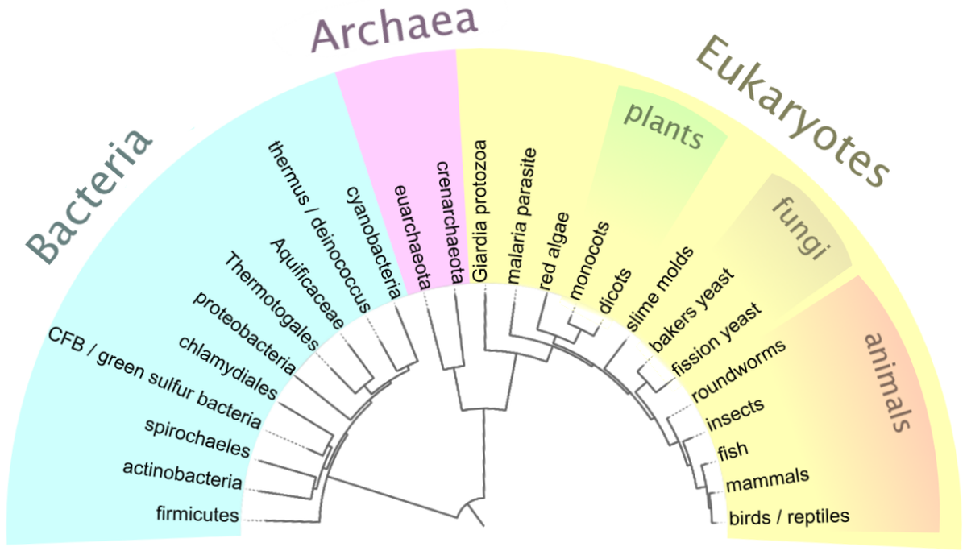
Phylogenomics & Phylogenetic Inference
Trees & “tree thinking”
Vi Varga
Department of Life Sciences Chalmers University of Technology
virag.varga@chalmers.se
Based on a lecture by:
Mats Töpel
Department of Marine Sciences University of Gothenburg
eDNA solutions AB
mats.topel@marine.gu.se
Tree of Life
(Wikimedia Commons)

Slide 2
Phylogenetic inference
A phylogenetic tree is a hypothesis of the relationships between selected species, sequences, etc.
Morphological data
Behavioral data
Sequence data
Notes:
Emphasize how important sequence data is, now that we have it!!!
Human Genome Project 1990-2003

Slide 3
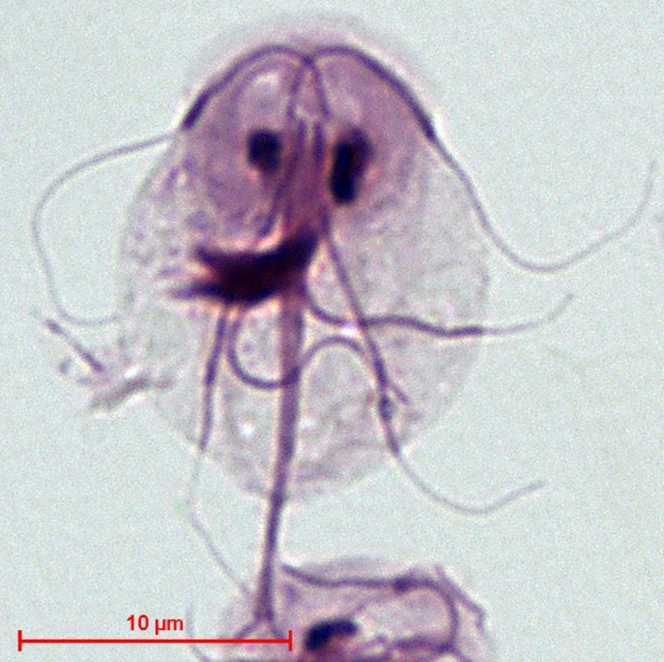
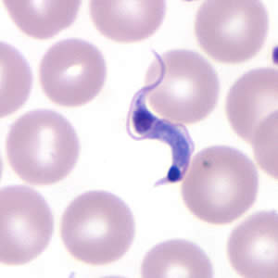
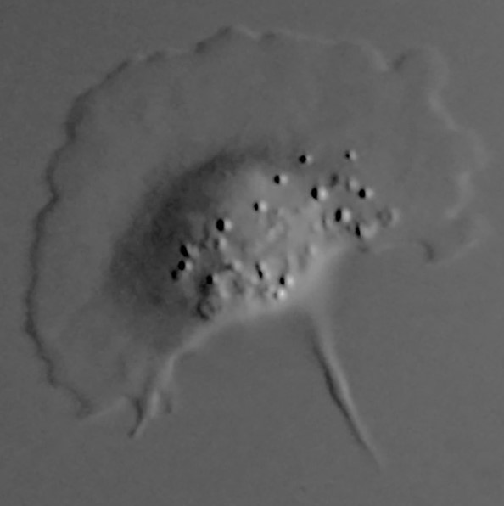
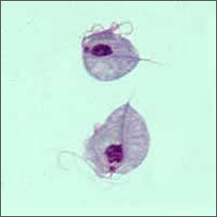
Introducing our example organisms
Anaeramoeba flamelloides
Giardia intestinalis
Trichomonas vaginalis
Trypanosoma cruzi
Notes:
Quick introduction for all organisms: protists (single-celled eukaryotes)
A. flamelloides: doesn’t cause disease, waters & soils, Stairs et al. 2021, anaerobe that can survive with oxygen
G. intestinalis: causes disease in humans & animals, fecal-oral route (lack of clean water), anaerobe that can survive with oxygen
T. vaginalis: most common protozoan STI, exclusively in humans, anaerobe that can survive with oxygen
T. cruzi: causative agent of Chagas disease (roughly 14.000 deaths/year: https://www3.paho.org/hq/index.php?option=com_content&view=article&id=13566:chagas-in-americas&Itemid=0&lang=en#gsc.tab=0), animals & humans, vector-borne, needs oxygen

Slide 4
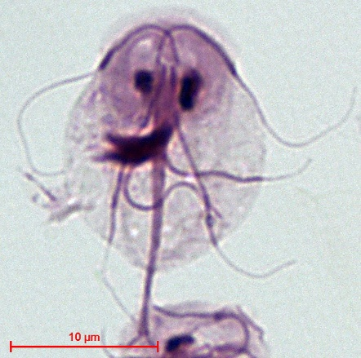



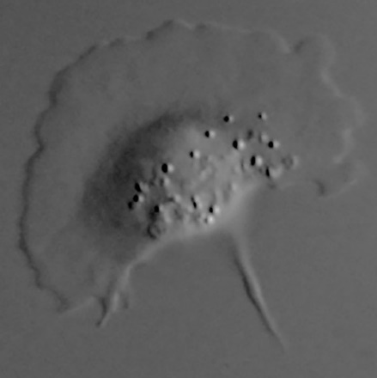
Phylogenetic inference: A simple example
Giardia intestinalis (Wikimedia Commons)
Trichomonas vaginalis
(CDC)
Anaeramoeba flamelloides
(Stairs et al. 2021)
Trypanosoma cruzi
(CDC)
Notes:
All organisms are related in some way – the question is “only” how
Call back to the different types of data we have available: start with the morphology

Slide 5
Phylogenetic inference: A simple example
Giardia intestinalis (Wikimedia Commons)
Trichomonas vaginalis
(CDC)
Roughly symmetrical along vertical axis
Undulating
membrane
Anaeramoeba flamelloides
(Stairs et al. 2021)
Trypanosoma cruzi
(CDC)
Notes:
Point out on the screen where these morphological characteristics are visible
Note that the roundness of trich is kind of misleading – protist morphology is weird that way, but Tvag can be a bit longer/more oval-shaped
All 4 seem to have a primary flagellum

Slide 6
So what do you think the tree looks like?
Discuss with the people next to you!

Slide 7
Phylogenetic inference: A “simple” example
Anaerobes unaffected by oxygen
Giardia intestinalis (Wikimedia Commons)
Trichomonas vaginalis
(CDC)
Roughly symmetrical along vertical axis
Undulating
membrane
Needs oxygen to survive
Anaeramoeba flamelloides
(Stairs et al. 2021)
Trypanosoma cruzi
(CDC)
Notes:
Adding more behavioral/lifestyle information to our tree – is it useful, though?

Slide 8
What do you think now? Would you change your species tree?
Discuss with the people next to you!

Slide 9
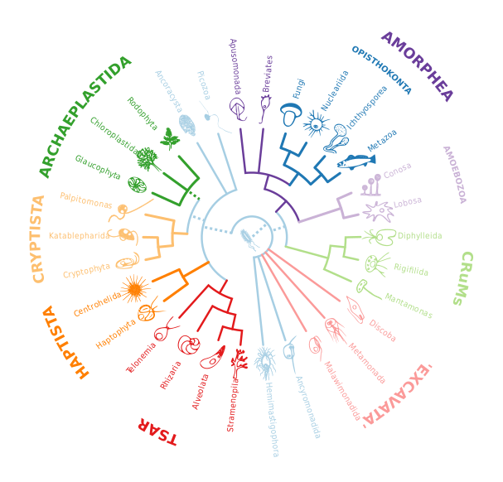
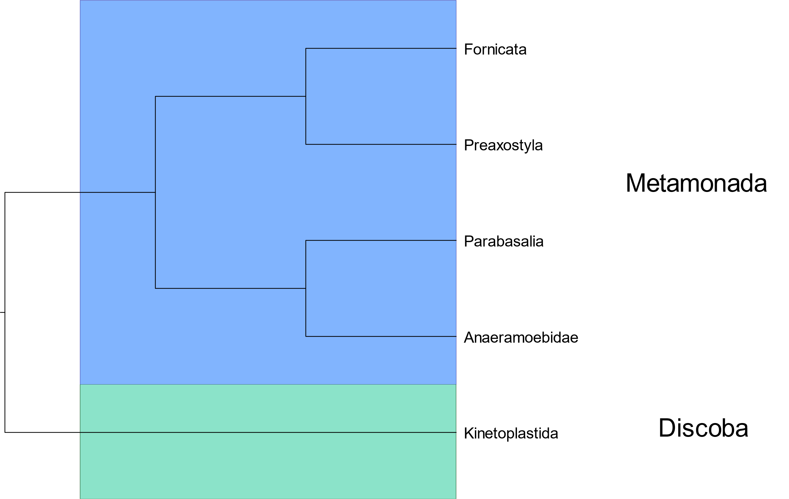




They may look similar, but the genetic distance is quite large!
Notes:
Note: Trypanosomes are kinetoplastids, which are part of Euglenozoa, which is itself part of Discoba
The other three are from Metamonada

Slide 10

But remember: Trees are flexible!
You can think of trees like mobiles: the various branches can rotate around each other freely, because the relative distances of species are actually determined by the placement of the nodes.
Alexander Calder – Twenty leaves and an apple (1946)

Slide 11
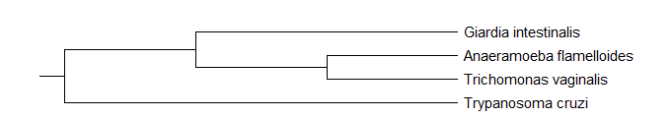
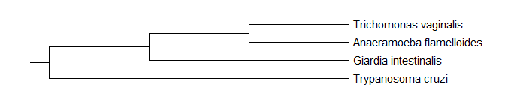
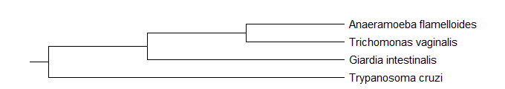
So all of these trees depict the exact same relationships:

Slide 12
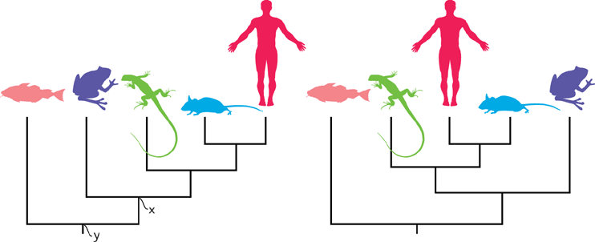
Which brings us to an important point:
Phylogenetic trees do not show how evolved any given species is, compared to another
Phylogenetic trees simply depict relationships between species, strains, or genes
Baum et al. 2005
Notes:
Discuss relatedness: Frog more closely related to a human than a fish – have more shared nodes in their ancestry
Earlier-branching species are not ancestors of later-branching ones
Evolutionary time cannot be inferred from a typical phylogenetic tree – there are specialized programs for this
All extant species are equally “evolved”
Species with more nodes in their history are not more evolved
Evolution didn’t “stop” at any given branch – the last common ancestor of humans and lizards likely looked nothing like either of these two organisms look today

Slide 13
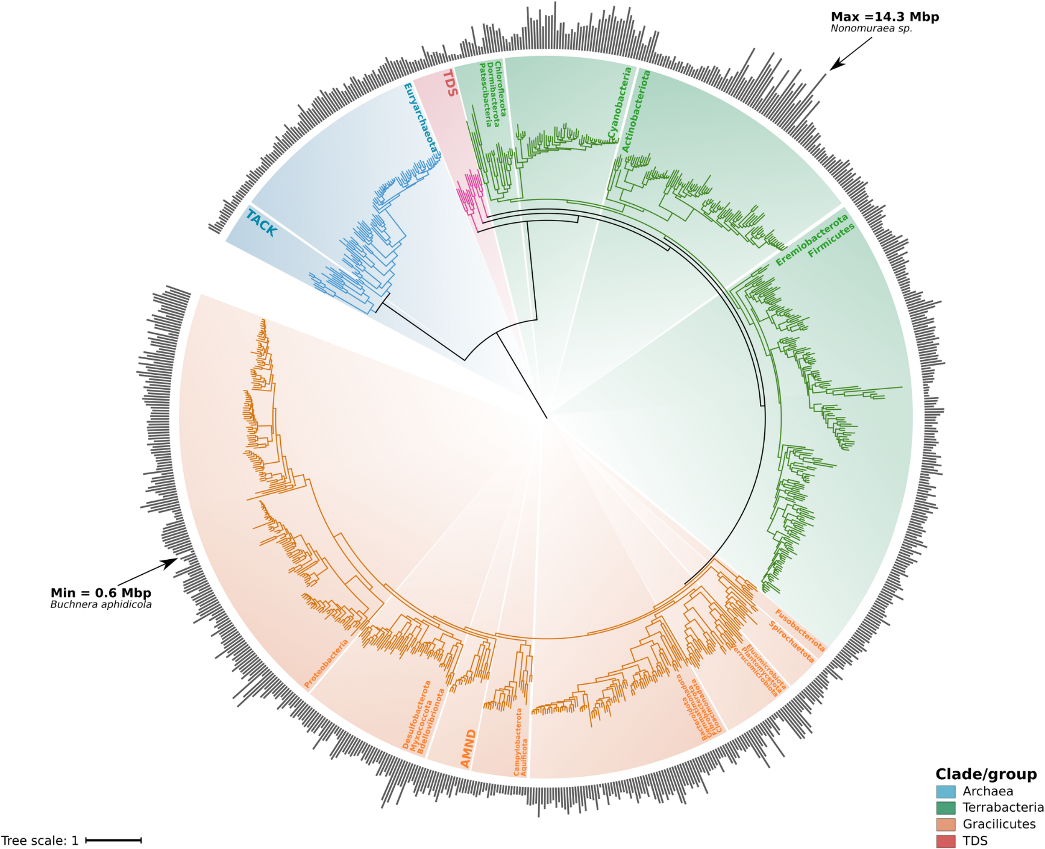
Genome size distribution across the Tree of Life of bacteria and archaea using one representative genome for each genus.
Martinez-Gutierrez & Aylward 2022

Slide 14
Nomenclature of Trees

Slide 15




Nomenclature of Trees
Leaf
Leaf – (observed)
existing sequences / species
Node – (Inferred)
Speciation event
Gene duplication
An internal node is an inferred
ancestor
Branch – (Inferred)
Connects nodes and leafs
Connects internal nodes
Ancient populations
Node
A
Branch
B
C
D

Slide 16

Nomenclature of Trees
Leaf – (observed)
existing sequences / species
Node – (Inferred)
Speciation event
Gene duplication
An internal node is an inferred
ancestor
Branch – (Inferred)
Connects nodes and leafs
Connects internal nodes
Ancient populations
Root – (Inferred or placed based on assumptions)
Indicates oldest node in tree
Adds evolutionary direction
Leaf
Node
A
Branch
B
Root
C
D

Slide 17
Nomenclature of Trees
Leaf – (observed)
existing sequences / species
Node – (Inferred)
Speciation event
Gene duplication
An internal node is an inferred
ancestor
Branch – (Inferred)
Connects nodes and leafs
Connects internal nodes
Ancient populations
Root – (Inferred or placed based on assumptions)
Indicates oldest node in tree
Adds evolutionary direction
Leaf
Node
A
Branch
B
Root
C
D
Evolutionary direction

Slide 18

Nomenclature of Trees
Now
Leaf – (observed)
existing sequences / species
Node – (Inferred)
Speciation event
Gene duplication
An internal node is an inferred
ancestor
Branch – (Inferred)
Connects nodes and leafs
Connects internal nodes
Ancient populations
Root – (Inferred or placed based on assumptions)
Indicates oldest node in tree
Adds evolutionary direction
t3
t2 t1
A
B
Root
C
D
Evolutionary direction
(More ancient) (More recent)

Slide 19

Nomenclature of Trees
Leaf – (observed)
existing sequences / species
Node – (Inferred)
Speciation event
Gene duplication
An internal node is an inferred
ancestor
Branch – (Inferred)
Connects nodes and leafs
Connects internal nodes
Ancient populations
Root – (Inferred or placed based on assumptions)
Indicates oldest node in tree
Adds evolutionary direction
A
Polytomy
B
C
D
Polytomy
Evolutionary relationship has not been fully resolved

Slide 20




Nomenclature of Trees
Leaf – (observed)
existing sequences / species
Node – (Inferred)
Speciation event
Gene duplication
An internal node is an inferred
ancestor
Branch – (Inferred)
Connects nodes and leafs
Connects internal nodes
Ancient populations
Root – (Inferred or placed based on assumptions)
Indicates oldest node in tree
Adds evolutionary direction
A
B
Clade
“Sisters”
C
Clade
D
Notes:
A clade is a piece of a phylogeny that includes an ancestral lineage and all the descendants of that ancestor.

Slide 21




Nomenclature of Trees
Most Recent Common Ancestor (MRCA)
A
Monophyletic group
Monophyly
Common origin
Includes all offspring of MRCA
e.g. “Mammals”
Ancestor
B
C
D
E

Slide 22


Nomenclature of Trees
A
B
C
Paraphyly
Common origin
Excluding some offspring of MRCA
e.g “Green algae”
D
Paraphyletic group
E

Slide 23


Nomenclature of Trees
A
B C
Polyphyletic group
D
E
Polyphyly
Different origins
e.g. “algae”

Slide 24
Nomenclature of Trees
Rooted tree:
The root indicates the common ancestor of all leaves on the tree
Unrooted tree:
Direction of evolution is not indicated

Slide 25
Rooting the Tree

Slide 26
Placing the root on the tree is a very important step of the analysis
Many programs for phylogenetic inference will automatically place a root on the tree
Make this a conscious decision instead
The position of the root may greatly influence your interpretation of the result
So how can you root a tree?
Outgroup rooting
Midpoint rooting

Slide 27
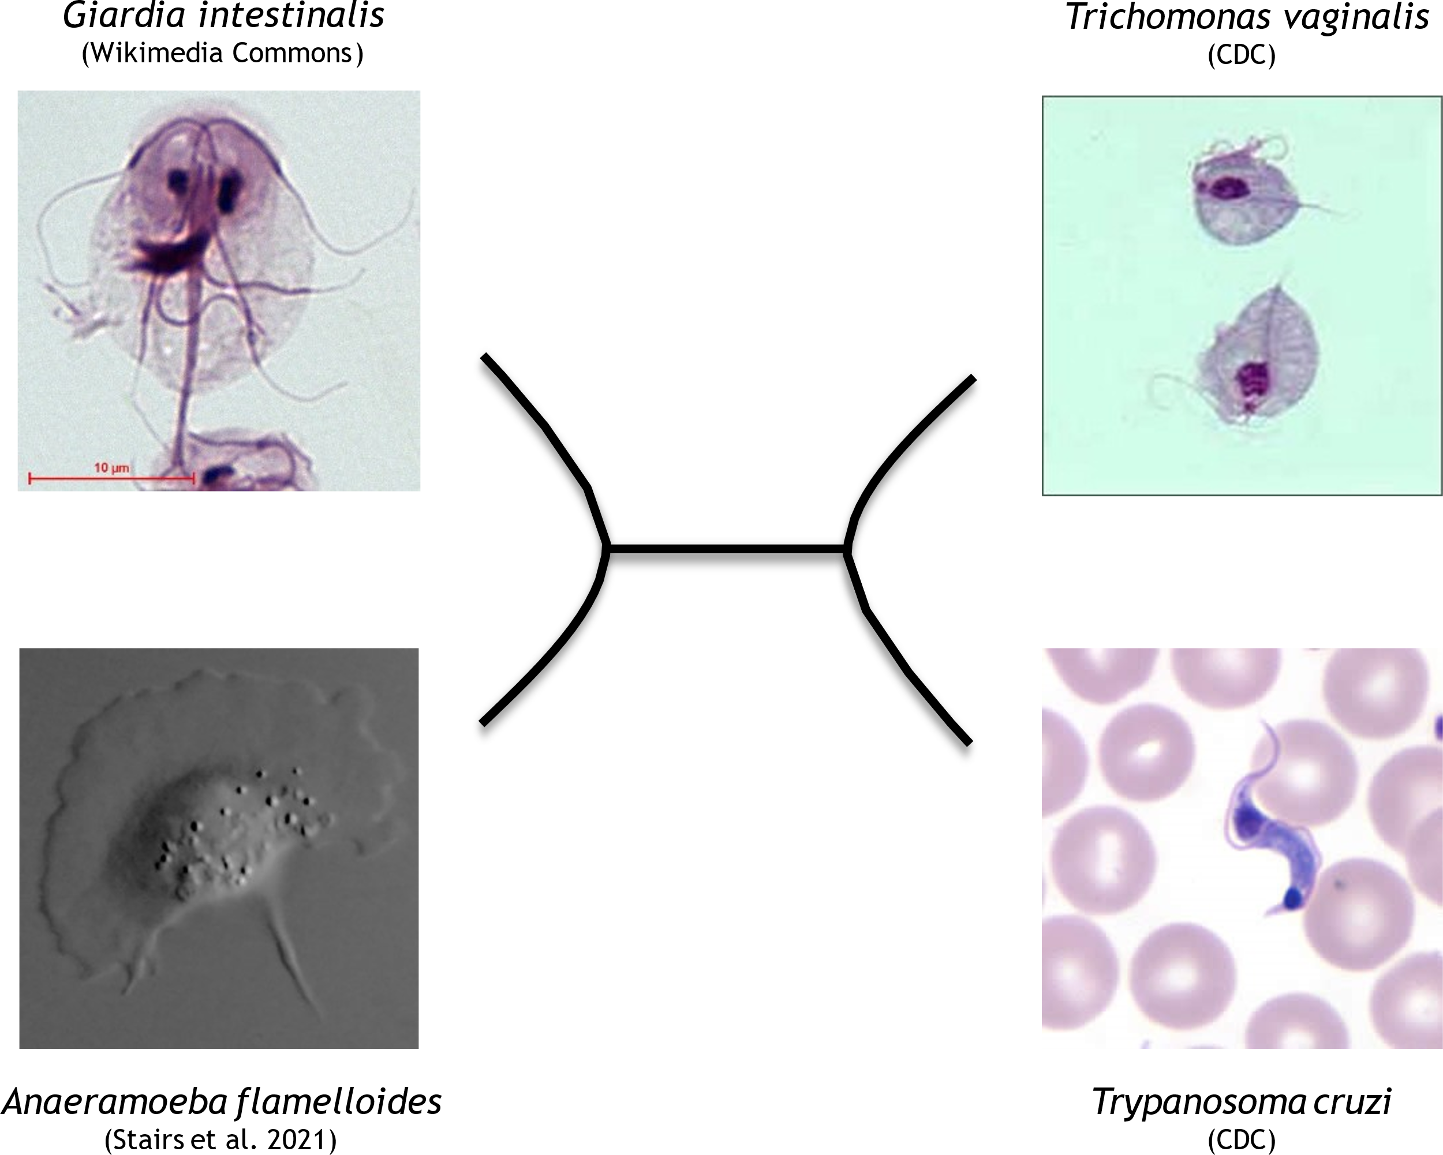
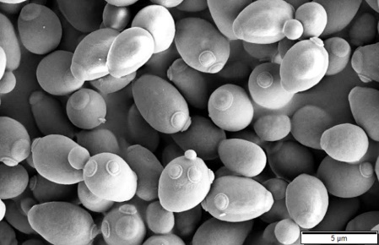
Rooting the tree: Outgroup rooting
What is an outgroup?
A species that is related to all organisms in the analysis…
But not so closely that it would confuse the phylogenetic signal
“Goldilocks scenario”
So what could serve as a good outgroup for us?
We’ll go with yeast (Saccharomyces cerevisiae)
Notes:
What makes a good outgroup?
Generally want a species that is related enough to show some phylogenetic similarities…
But not so closely related that it will confuse the signal
So basically, it’s a Goldilocks situation – you don’t want too distant of a relative, or too close of one
This unfortunately means that for any analysis you do, you’ll need to evaluate the species you’re analyzing, and make the decision with your research group for what species to use as an outgroup
Among our 4 species, T. cruzi could probably serve as an outgroup for the other 3, since it’s in an entirely different supergroup.
However, if we want all 4 on 1 tree, and an outgroup to them, it needs to be a more distant species

Slide 28
Rooting the tree: Outgroup rooting
Using yeast (Saccharomyces cerevisiae) as our outgroup
The root will be placed on the branch leading to the outgroup
Notes:
What makes a good outgroup?
Generally want a species that is related enough to show some phylogenetic similarities…
But not so closely related that it will confuse the signal
So basically, it’s a Goldilocks situation – you don’t want too distant of a relative, or too close of one
This unfortunately means that for any analysis you do, you’ll need to evaluate the species you’re analyzing, and make the decision with your research group for what species to use as an outgroup
Among our 4 species, T. cruzi could probably serve as an outgroup for the other 3, since it’s in an entirely different supergroup.
However, if we want all 4 on 1 tree, and an outgroup to them, it needs to be a more distant species

Slide 29
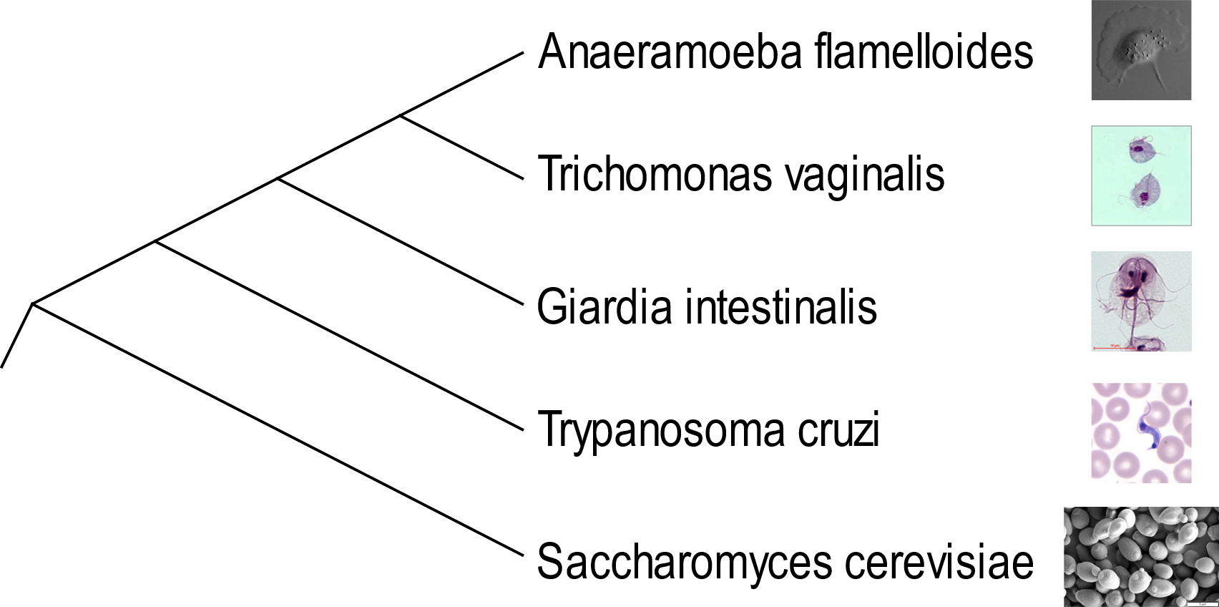

Rooting the tree: Outgroup rooting
Ingroup
Outgroup

Slide 30

Rooting the tree: Midpoint rooting
Look for the greatest distance between two leaves
Count the lines, and include the midline/midpoint in your calculations
Here, we’ll start with the assumption that all of these species are equidistant from each other
The longest distance between any two leaves is 3
1
1
1
1
1

Slide 31
Rooting the tree: Midpoint rooting
Midpoint
The longest distance between any two leaves is 3
The midpoint is at 1.5
1
1
1
1
1

Slide 32
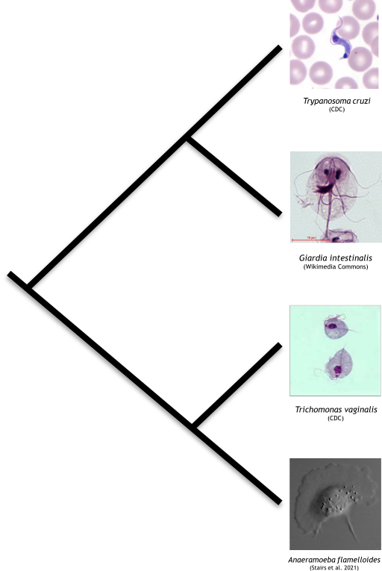
Rooting the tree: Midpoint rooting

Slide 33
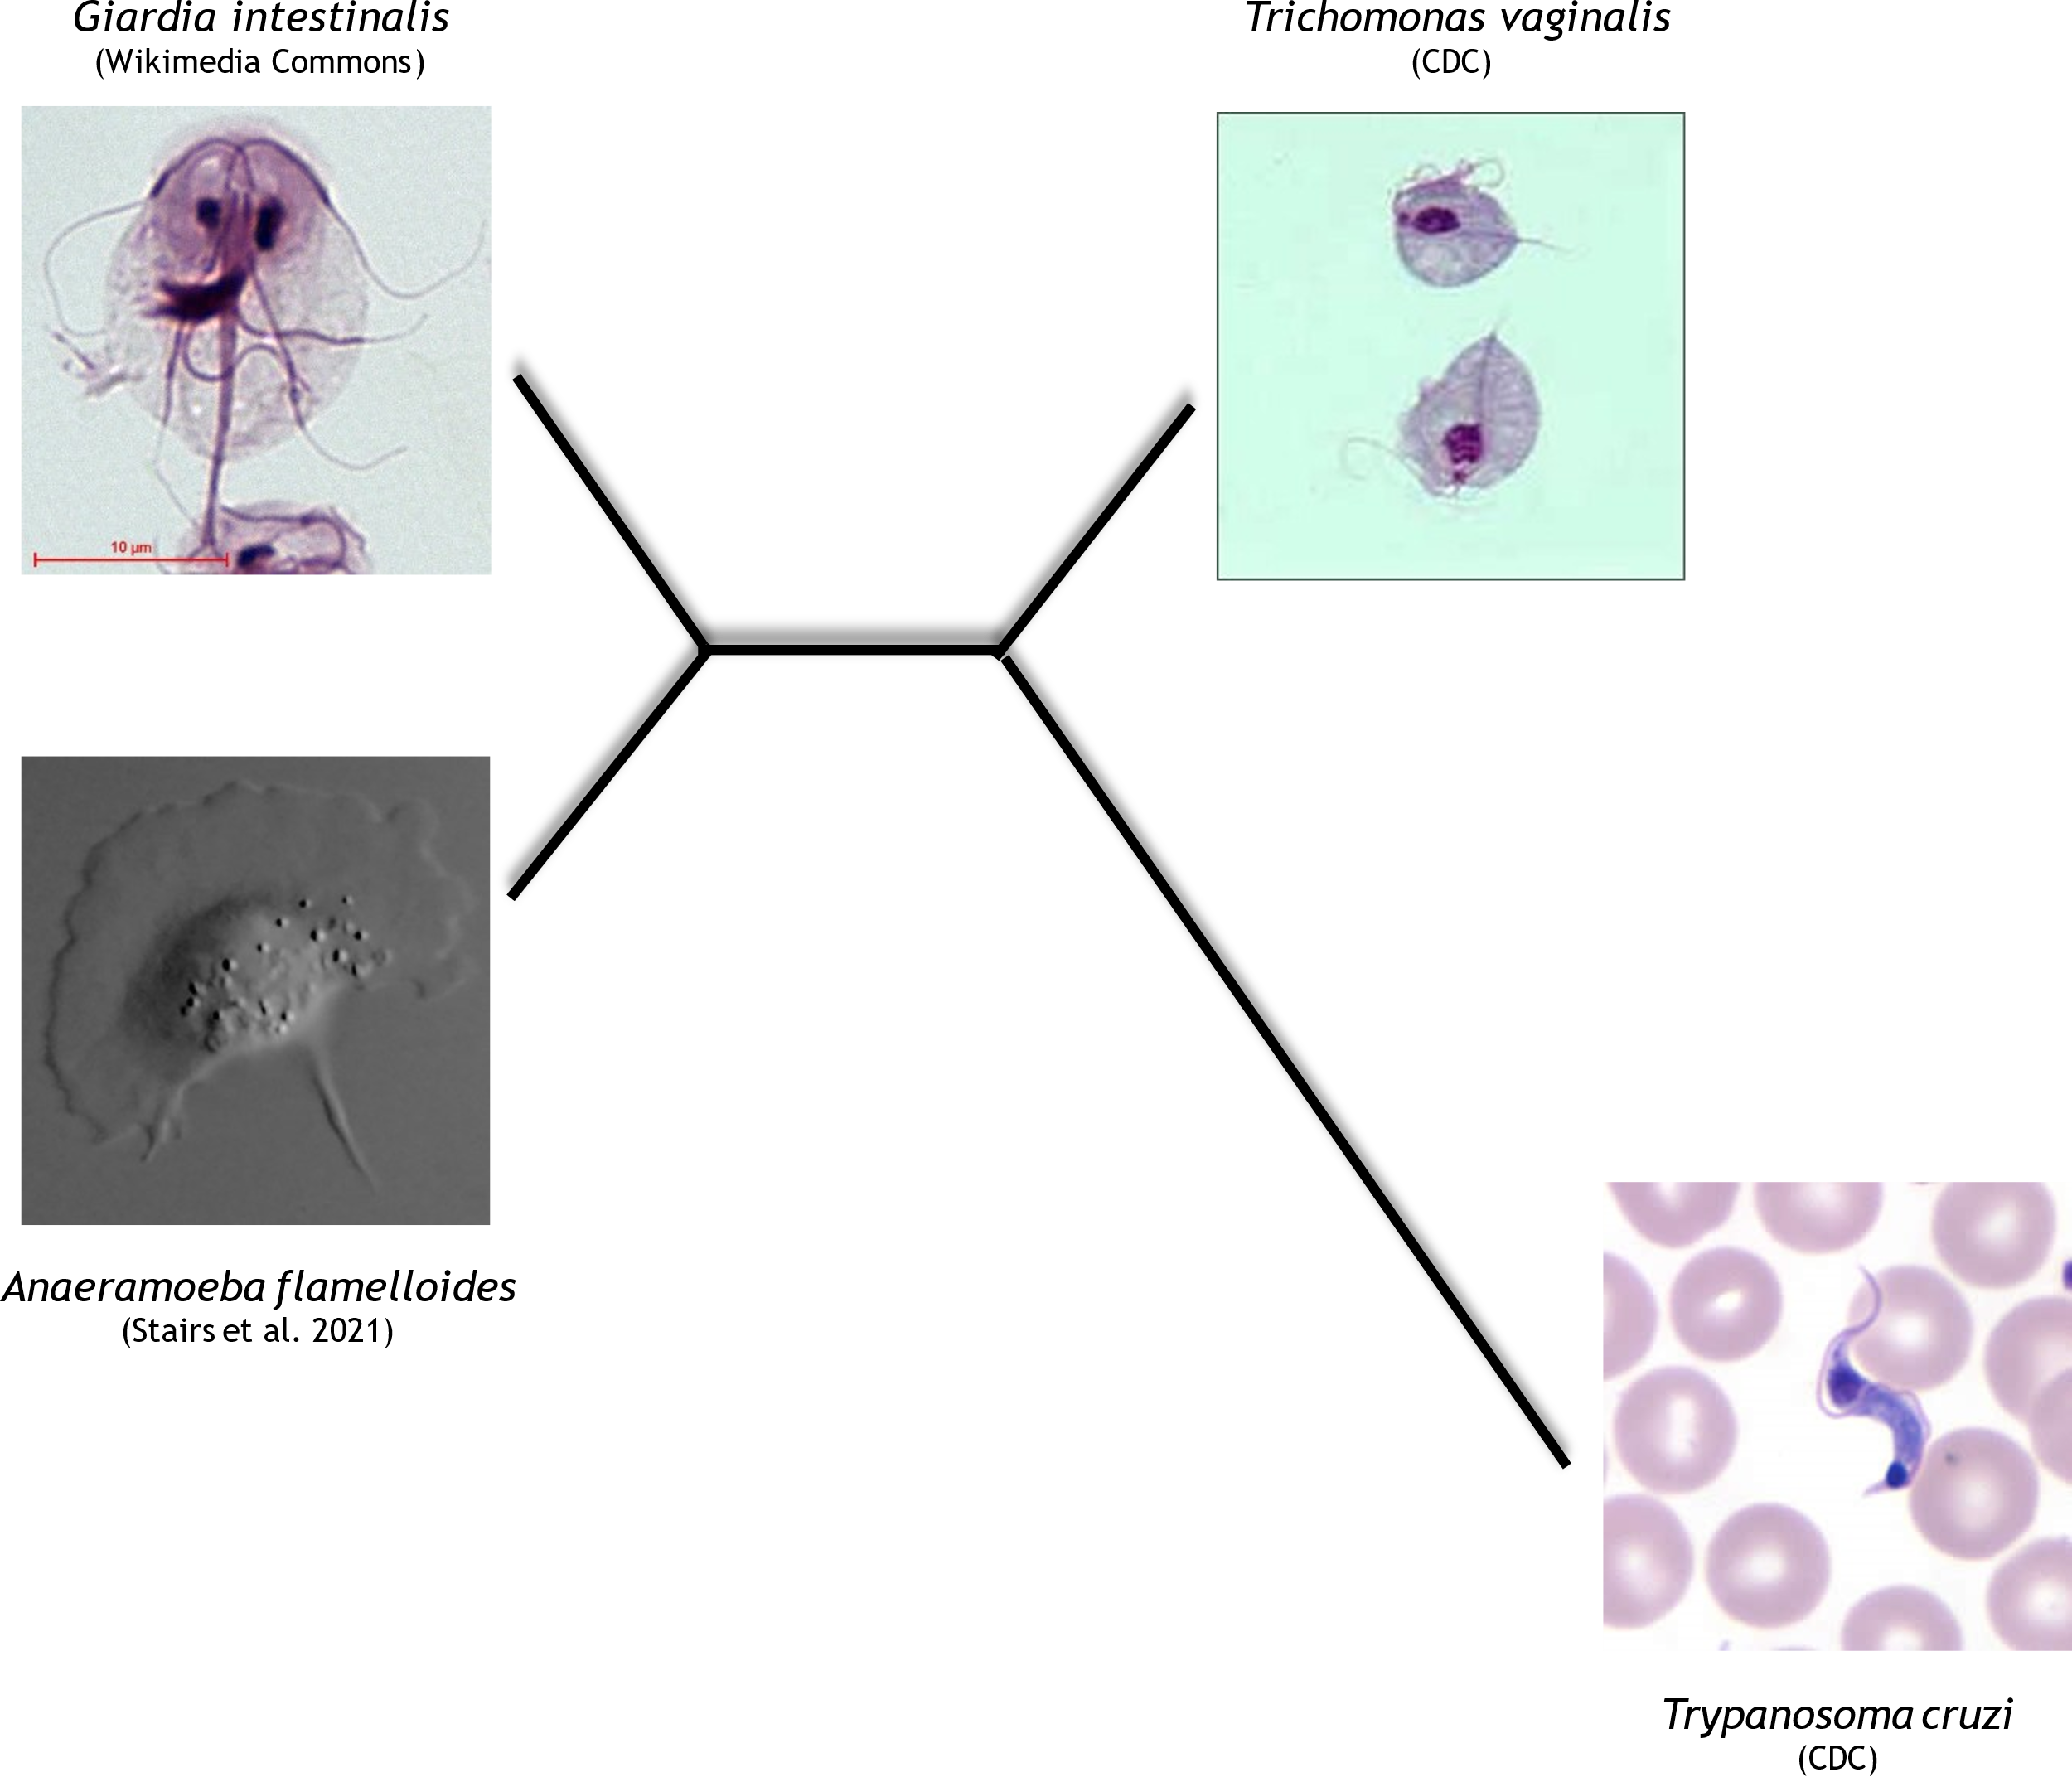
Rooting the tree: Midpoint rooting
1
1
Now let’s take an example where the distances between the leaves are different
Here, the longest distance between any two leaves is 5
1
1
3
Midpoint

Slide 34
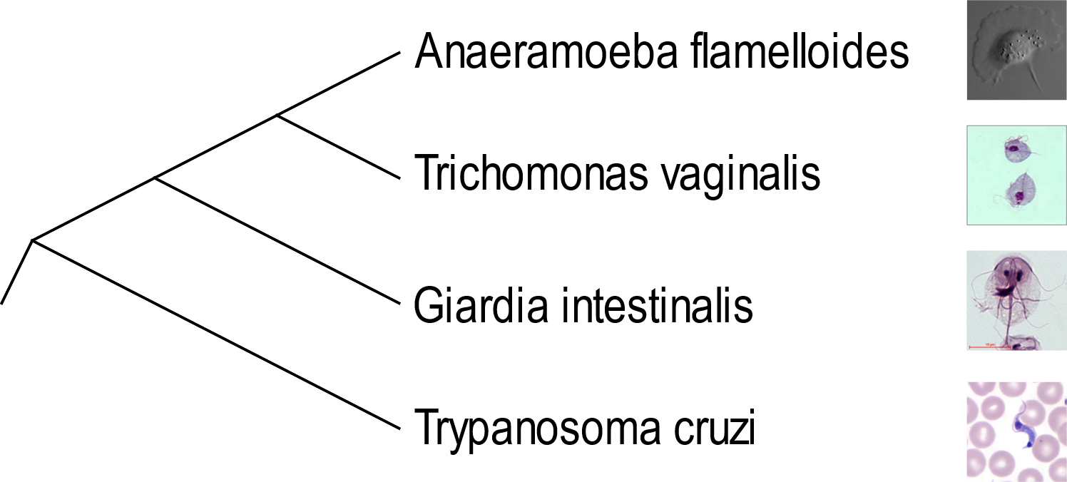
Rooting the tree: Midpoint → Outgroup

Slide 35
Molecular Phylogeny

Slide 36
Molecular phylogeny: Applications of phylogenetic methods
Reconstruction of evolutionary history
Species relationships
Gene family evolution
Estimating divergence times
Reconstructing ancient proteins
Identification of horizontal gene transfer events

Slide 37
Molecular phylogeny: Species tree
A
B
Speciation

Slide 38





Molecular phylogeny: Gene tree
A₁
Analysis of 4 sequences from species A and B
B₁
A₂
B₂
Notes:
Mention how this happens: gene duplication

Slide 39







Molecular phylogeny: Gene tree vs. Species tree
Gene duplication
A
B
Speciation

Slide 40
Molecular phylogeny: Gene tree vs. Species tree
Gene duplication
A₁
B₁
Speciation
A₂
B₂
Notes:
Mention how this happens: gene duplication

Slide 41
Molecular phylogeny: Homology
Homology is the relationship between genes that share a common ancestor
These genes can come from the same or different species
Ancestry from the perspective of the gene
Shared ancestry
Gene duplication
A₁
B₁
Speciation
Homologues
A₂
B₂
Notes:
Ref: https://link.springer.com/protocol/10.1007/978-1-4939-9074-0_5

Slide 42
Molecular phylogeny: Orthology
Orthology is the relationship between two homologous genes, where the genes have evolved through a speciation event
These genes exist in different species – separated by a speciation event
Ancestry from the perspective of the gene
Gene duplication
A₁
Orthologues
B₁
Speciation
A₂
Orthologues
B₂
Notes:
Ref: https://link.springer.com/protocol/10.1007/978-1-4939-9074-0_5

Slide 43

A quick vocab check-in…
True/False: All homologs are orthologs.
False
Orthologs must be separated by a speciation event…
While homologs can occur in the same species

Slide 44
Molecular phylogeny: Paralogy
Paralogy is the relationship between two homologous genes which have evolved through a process of gene duplication
In essence, they are separated by a gene duplication event
Ancestry from the perspective of the gene
Gene duplication
A₁
Paralogues
B₁
Speciation
A₂
Paralogues
B₂
Notes:
Ref: https://link.springer.com/protocol/10.1007/978-1-4939-9074-0_5

Slide 45
A quick vocab check-in…
True/False: Paralogous genes are also homologous.
True
Both orthologs and paralogs are specific types of homologs

Slide 46






Molecular phylogeny: Gene tree vs. Species tree
Gene tree
Species tree
A₁
B₁
A
How can this gene tree be explained given this species tree?
C₁
A₂
B
B₂
C
C₂

Slide 47















Molecular phylogeny: Gene tree vs. Species tree
Gene tree
Species tree
A₁
B₁
A
Is this strange tree a result of gene loss?
C₁
C
A₂
B
B₂
A, B
C
C₂

Slide 48







Molecular phylogeny: Gene tree vs. Species tree
Gene tree
Species tree
A₁
B₁
A
… Or a result of poor sampling?
C₁
C*
A₂
B
B₂
A*
B*
C
C₂

Slide 49
Molecular phylogeny: Gene tree vs. Species tree
Gene tree
Species tree
A₁
B₁
Gene duplications
A
C₁
“Deep coalescence” or
“Incomplete lineage sorting”
A₂
B
B₂
C
C₂
Speciation
Notes:
Incomplete lineage sorting, also termed hemiplasy, deep coalescence, retention of ancestral polymorphism, or trans-species polymorphism, describes a phenomenon in population genetics when ancestral gene copies fail to coalesce (looking backwards in time) into a common ancestral copy until deeper than previous speciation events.

Slide 50
Brainstorming Activity: What kind of gene should you use to reconstruct a species tree?
“Goldilocks” situation balancing genes that are unique but not too unique, and evolve at a meaningful speed (i.e., not too fast, not too slow)
In all of these “extreme” cases, the phylogenetic signal can become confused
This a situation where you have to get to know the organisms you’re working with, and pick the gene that’s just right

Slide 51
Quick Review: Biological Concepts

Slide 52
What are the 4 macromolecules?
Carbohydrates – (CH₂O)_{n}
Lipids – primarily hydrocarbon chains
Nucleic Acids – nucleotides (nitrogenous base with sugar & phosphate group backbone)
Proteins – amino acids (20 standard)

Slide 53
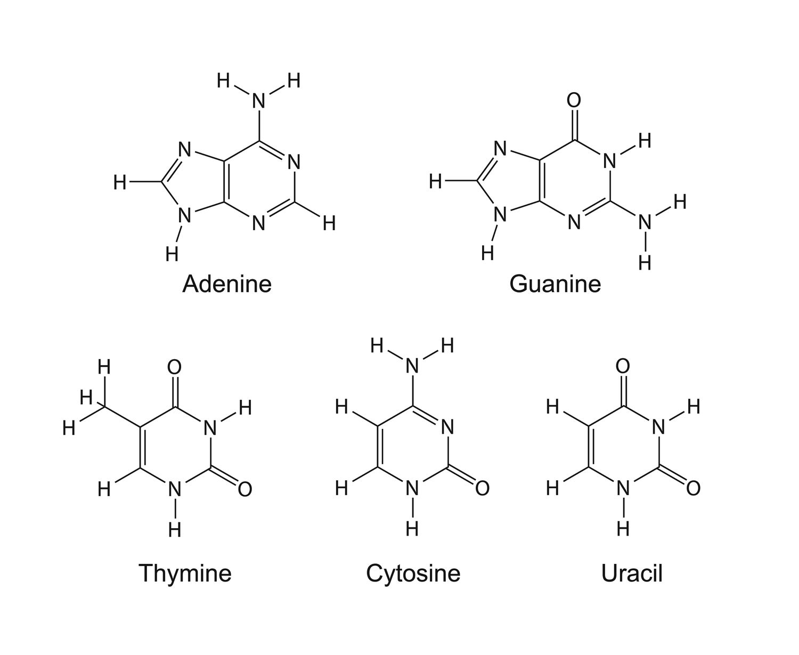
Which are the pyrimidines and which are the purines?
Purines
Pyrimidines
Notes:
“Angels & Gods are Pure”

Slide 54
The Central Dogma
Transcription
5’ cap
Poly-A tail
Splicing
mRNA Processing
DNA
mRNA
mRNA
Translation
mRNA
Ribosome
Post-Translational Modifications
tRNA
Polypeptide chain
Amino Acids
Notes:
Graphics from Servier Medical Art

Slide 55
Phylogenetic Analysis

Slide 56
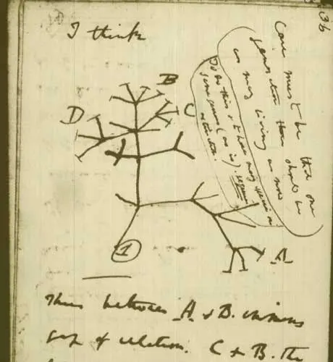
Notes:
Charles Darwin’s sketch of the tree of life (1837)

Slide 57
Phylogenetic analysis: Assumptions
Sequences included in the analysis are homologous
Evolution has been treelike
The alignment is correct (only homologous sites are aligned)
Highly similar genes are homologous (have the same ancestor).
Molecular difference in homologous genes (DNA or protein sequences) are positively correlated with the time of evolution.

Slide 58
Phylogenetic analysis: Workflow
Data: Selection of sequences for analysis
DNA, RNA, protein
BLAST, HMM
Multiple Sequence Alignment
CLUSTALW, MAFFT, MUSCLE
Construction of tree
Distance methods
Character methods: Maximum parsimony, Maximum likelihood, Bayesian methods
Evaluation of tree
Compare the resulting gene tree to the species tree.
Identify gene duplication and speciation events
Can you explain the pattern? Does it make sense?
If not, how can the result be explained?

Slide 59
Multiple Sequence Alignment

Slide 60
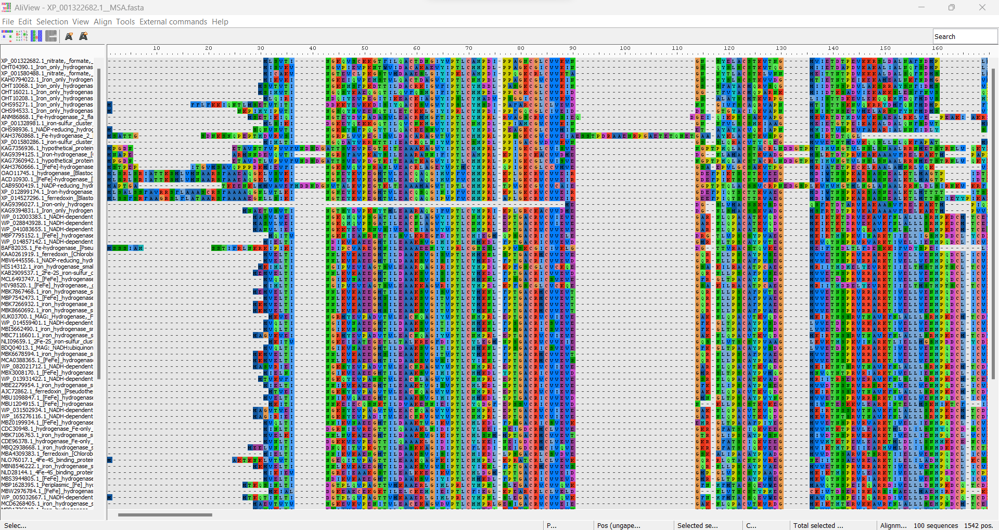
Multiple Sequence Alignment (MSA)

Slide 61
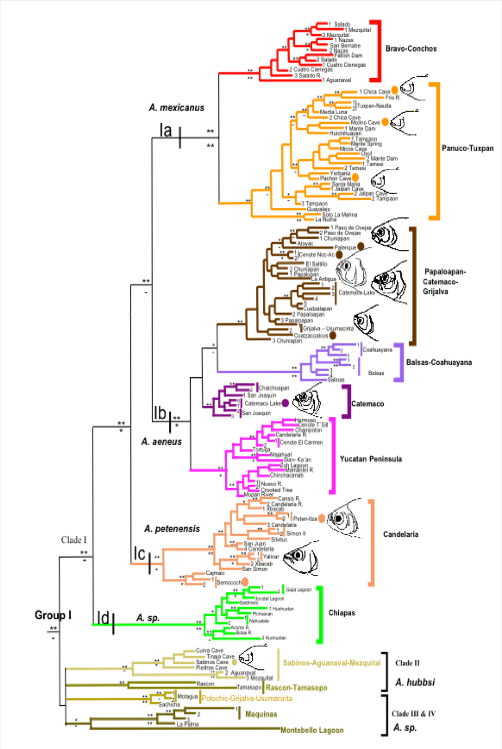
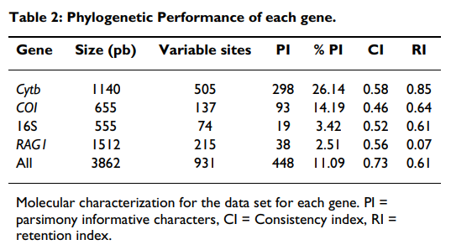

MSAs: Resolving relationships when morphology is hard to interpret
The genus Astyanax: Resolving the relationships using the Cytb gene (and other genes)
A site is parsimony-informative (PI) if it contains at least two types of nucleotides (or amino acids), and at least two of them occur with a minimum frequency of two.
Ornelas-García CP, Domínguez-Domínguez O, Doadrio I. Evolutionary history of the fish genus Astyanax Baird & Girard (1854) (Actinopterygii, Characidae) in Mesoamerica reveals multiple morphological homoplasies. BMC Evol Biol. 2008 Dec 22;8:340. doi: 10.1186/1471-2148-8-340. PMID: 19102731; PMCID: PMC2657800.
Notes:
Source: https://www.ncbi.nlm.nih.gov/pmc/articles/PMC2657800/
Citation: Ornelas-García CP, Domínguez-Domínguez O, Doadrio I. Evolutionary history of the fish genus Astyanax Baird & Girard (1854) (Actinopterygii, Characidae) in Mesoamerica reveals multiple morphological homoplasies. BMC Evol Biol. 2008 Dec 22;8:340. doi: 10.1186/1471-2148-8-340. PMID: 19102731; PMCID: PMC2657800.
Parsimony-informative is a site in where at least there is two different character states for the sequence at that site. This site contains at least two types of nucleotides (or amino acids), and at least two of them occur with a minimum frequency which is required for the fewest evolutionary changes in the genome. (Source: Saha et al. 2020)

Slide 62
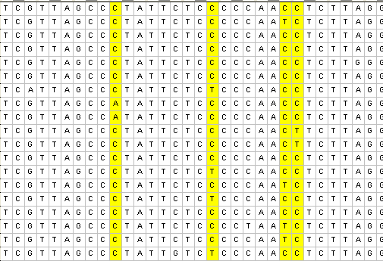
MSAs: Resolving relationships when morphology is hard to interpret
The genus Astyanax: Resolving the relationships using the Cytb gene (and other genes)
Ornelas-García CP, Domínguez-Domínguez O, Doadrio I. Evolutionary history of the fish genus Astyanax Baird & Girard (1854) (Actinopterygii, Characidae) in Mesoamerica reveals multiple morphological homoplasies. BMC Evol Biol. 2008 Dec 22;8:340. doi: 10.1186/1471-2148-8-340. PMID: 19102731; PMCID: PMC2657800.
Parsimony informative sites are highlighted in yellow.
Notes:
Source: https://www.ncbi.nlm.nih.gov/pmc/articles/PMC2657800/
Citation: Ornelas-García CP, Domínguez-Domínguez O, Doadrio I. Evolutionary history of the fish genus Astyanax Baird & Girard (1854) (Actinopterygii, Characidae) in Mesoamerica reveals multiple morphological homoplasies. BMC Evol Biol. 2008 Dec 22;8:340. doi: 10.1186/1471-2148-8-340. PMID: 19102731; PMCID: PMC2657800.

Slide 63
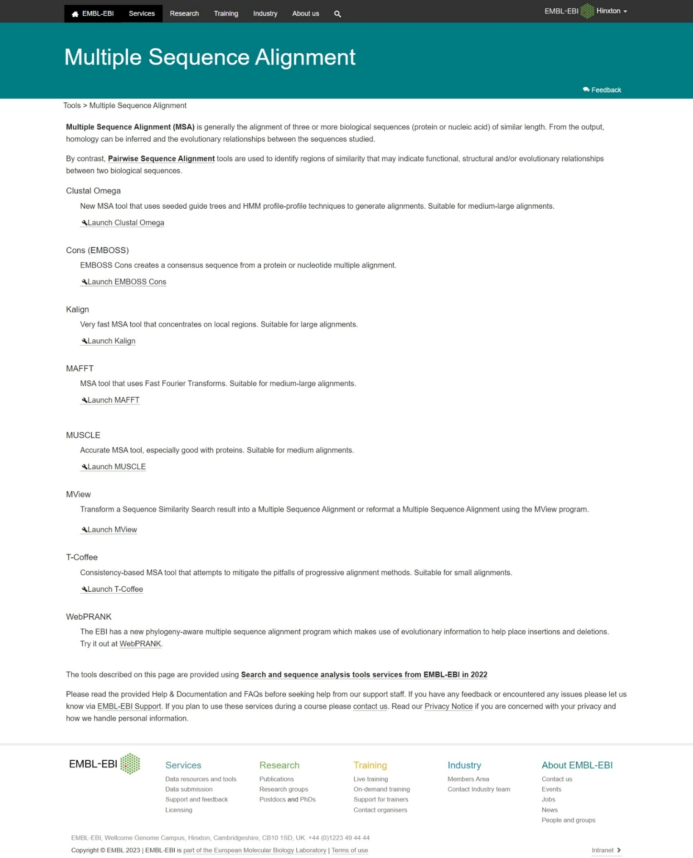
MSAs: Tools
https://www.ebi.ac.uk/Tools/msa/
Notes:
Source: https://www.ebi.ac.uk/Tools/msa/

Slide 64
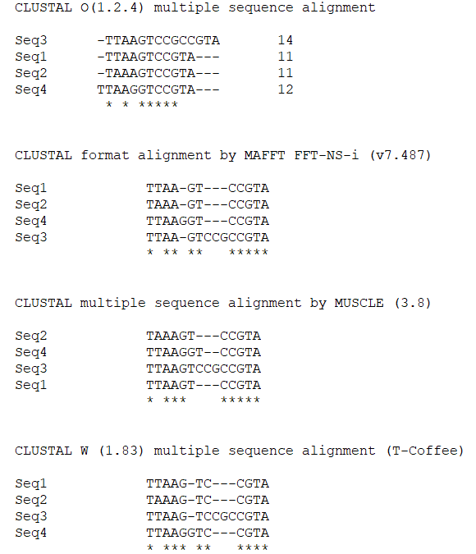
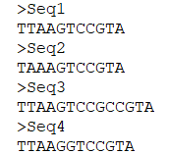
MSAs: Alignment results
Pairwise Alignment
GP = Gap penalty
g = gap opening penalty
h = gap extension penalty
l = gap length
GP = g + hl

Slide 65
MSAs: Common problems
Insertions/deletions “indels”
Duplications/repeats
High substitution rates
Size of alignment – computational limitations
The problem is more complicated than you initially think: It is impossible to evaluate all possible alignments
To align two sequences of length 100 and length 95 there are about 55 million possible alignments if you are only allowed to insert gaps in one of the sequences.

Slide 66
MSA Editing
Highly-variable regions
1. Start & end of sequence
2. Signal peptide
3. Flexible linker regions
4. Smaller gaps & areas of notably high variation
As with much of phylogenomics, cleaning an MSA is a “Goldilocks”-type of task
There’s no simple, straightforward solution
Some alignment-editing programs do exist – these make your workflow more reproducible, but are also less case-sensitive (might trim the wrong regions for your alignment)

Slide 67
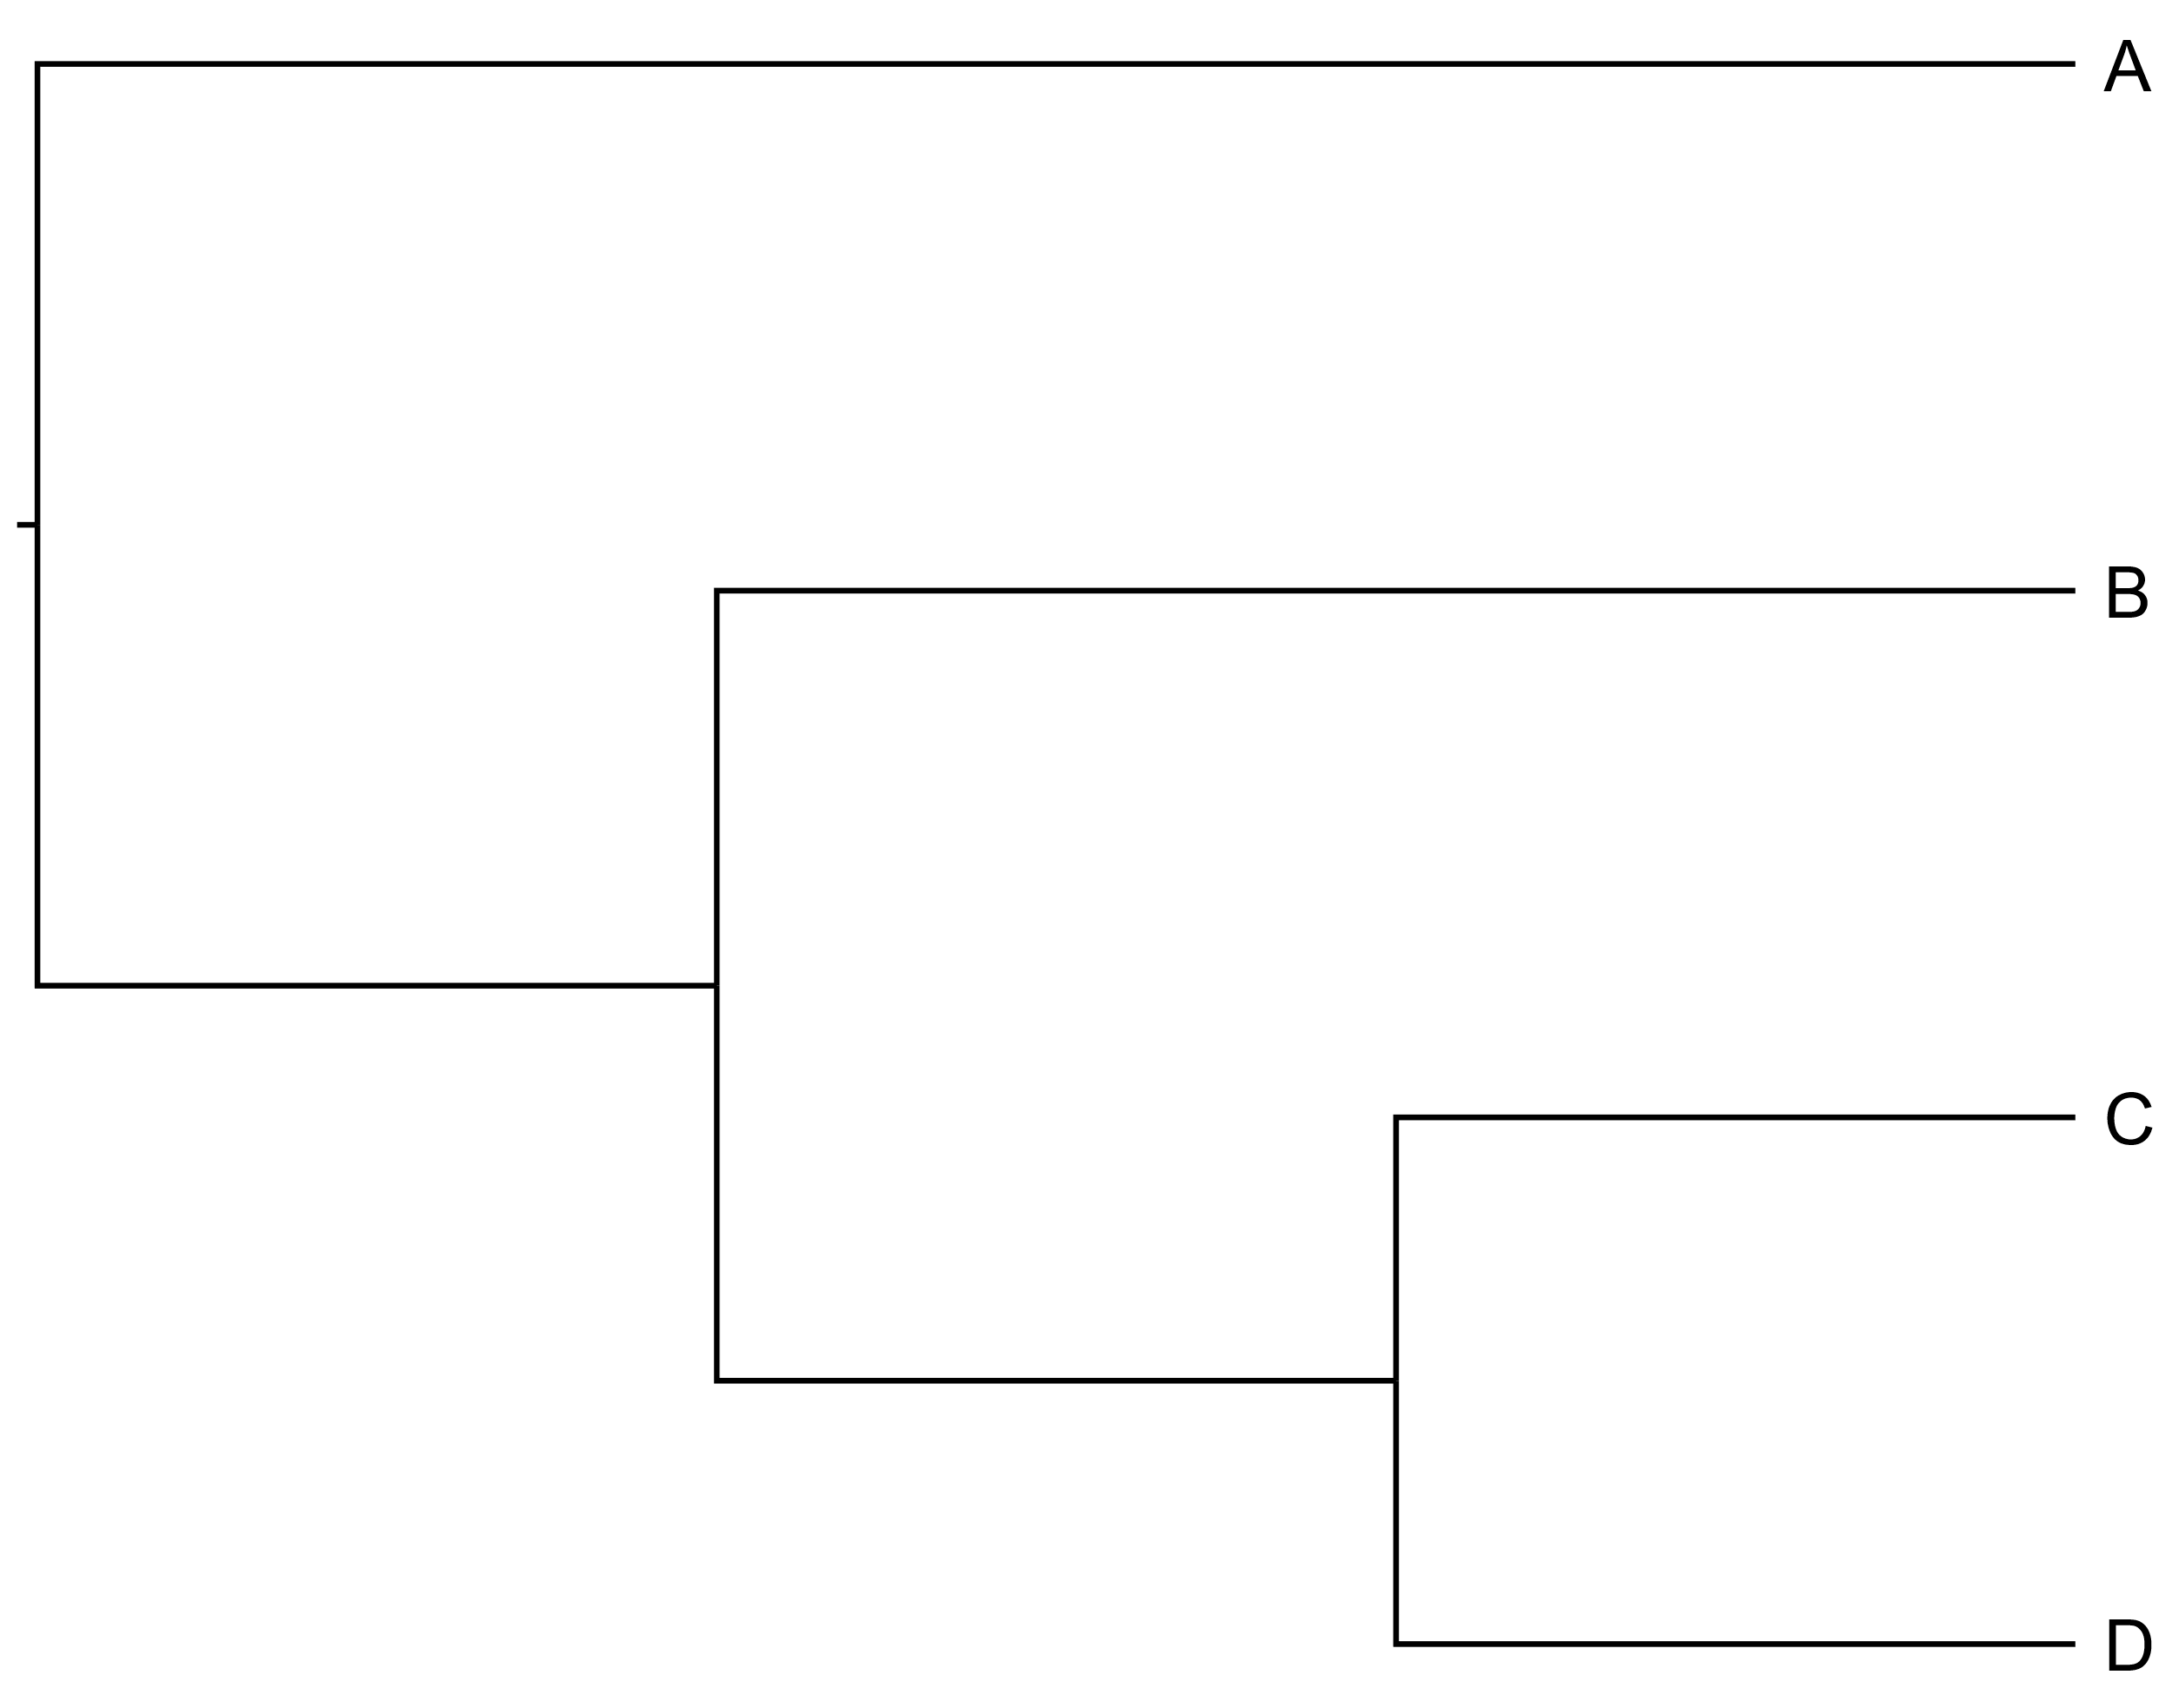
Phylogenetic Tree File Formats
Newick tree
Nexus
Phylip
(A,(B,(C,D)));
Notes:
Try to sketch out on the whiteboard how the tree would look, before confirming on the slide

Slide 68
Evolution & Phylogenomics

Slide 69
Principles of Evolution
At the molecular level, evolution is a process of mutation with selection.

Slide 70
Mutations: Changes in DNA base sequence
Single nucleotide change (point mutation)
Transition – purine to purine or pyrimidine to pyrimidine (C↔T and A↔G)
Transversion - purine to pyrimidine (A↔T and C↔G)
Insertion/Deletion (indel) of one or several nucleotides
Mutations are the result of
Replication errors
Chemicals & irradiation

Slide 71
Phylogenetic Methods
Distance based methods
Neighbor joining
UPGMA
Character based methods
Parsimony
Model bases methods
Maximum likelihood
Bayesian methods

Slide 72
Distance-Based Methods
Simplest distance measure
Consider every pair of sequences in the MSA and count the number of differences
For example:
D = 2
AGGCTTTTCA
AGCCTTCTCA

Slide 73
Distance-Based Methods
B | C | D
A - 2 | 4 | 6
B - - | 4 | 6
C - - | - | 6
>A
GGACCACTACGAGCGCCTACGACGTA
>B
GGACCCCTACGAGCCCCTACGACGTA
>C
GGACCGCTGCGAGCTTCTACGACGTA
>D
GGACCTCTCCGGGCAGCTAGGACGTA
A
D
4
1
B
1
1
2
C

Slide 74
Distance-Based Methods
Pros:
Computationally fast
Fairly intuitive
Cons:
Sensitive to saturation
Simple evolutionary model

Slide 75
Character-Based Methods
Maximum parsimony
Maximum likelihood
Bayesian inference
Notes:
ML – maximizes likelihood of the alignment
Bayesian – combines the information in the prior and in the data likelihood to create the so-called posterior probability of trees, which is the probability that the tree is correct given the data, the prior and the likelihood model
Bayesian inference is a method of statistical inference in which Bayes' theorem is used to update the probability for a hypothesis as more evidence or information becomes available.

Slide 76
Maximum Parsimony (MP)
Parsimony – principle in science where the simplest answer is preferred (i.e., Occam’s razor)
In phylogeny: The most parsimonious tree is the one that requires the fewest evolutionary steps to explain the data

Slide 77
Maximum Parsimony (MP)
Identify informative sites in the MSA.
For each possible tree, calculate the number of changes at each informative site.
Sum the number of changes for each possible tree.
The tree with the smallest number of changes is the most parsimonious tree.

Slide 78

Maximum Parsimony (MP)
>1
TATT
>2
TCGT
>3
CAGT
>4
CCGT
MP tree
4 steps
1
3
2
4

Slide 79






Maximum Parsimony (MP)
MP tree
1
3
2
4
Site 2 (2 steps)
>1
TATT
>2
TCGT
>3
CAGT
>4
CCGT
Site 1 (1 step)
T
C
A
A
A
A
or
A
A
C
C
T
C
C
C
C
T
C
C
Site 3 (1 step)
Site 4 (No steps)
T
G
T
T
G
G
T
T
G
G
T
T

Slide 80
Rooted vs. Unrooted Trees
Number of Sequences | Number of Unrooted Trees | Number of Rooted Trees
2 | 1 | 1
3 | 1 | 3
4 | 3 | 15
5 | 15 | 105
6 | 105 | 945
7 | 945 | 10.395
8 | 10.395 | 1235.1235
9 | 135.135 | 2.027.025
10 | 2.027.025 | 34.459.425
20 |  | 8.200.794.532.637.891.559.000
135 | (Exceeds the number of particles in the known Universe)

Slide 81
Tree Support & Bootstrapping
Process:
Take a random subsample of columns in the alignment and run the analysis again
Take another sample of columns and analyze again.
Repeat!
The same column in the alignment can be included in different bootstrap replicates.
A clade found in 95% of the samples has a bootstrap support of 95.

Slide 82
Tree Evaluation
Compare gene tree(s) to species tree
Does it make sense?
Critical evaluation of incongruous trees:
Horizontal/lateral gene transfers?
For species trees: Did you pick a useful gene?
Notes:
HGT: Particularly relevant if the gene & species trees mostly line up, but there’s a few genes that seem to have unique patterns

Slide 83
Summing Up

Slide 84
Phylogenetic analysis: Workflow
Data: Selection of sequences for analysis
DNA, RNA, protein
BLAST, HMM
Multiple Sequence Alignment
CLUSTALW, MAFFT, MUSCLE
Construction of tree
Distance methods
Character methods: Maximum parsimony, Maximum likelihood, Bayesian methods
Evaluation of tree
Compare the resulting gene tree to the species tree.
Identify gene duplication and speciation events
Can you explain the pattern? Does it make sense?
If not, how can the result be explained?

Slide 85
Molecular phylogeny: Applications of phylogenetic methods
Reconstruction of evolutionary history
Species relationships
Gene family evolution
Estimating divergence times
Reconstructing ancient proteins
Identification of horizontal gene transfer events

Slide 86
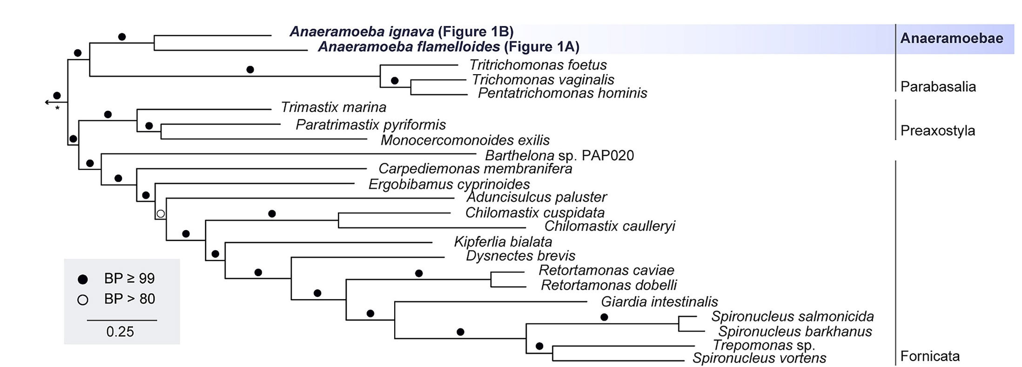
Tutorial
Stairs et al. 2021 – Phylogeny of Metamonada
(Will provide link later)

Slide 87
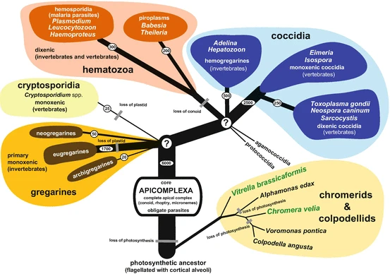
Exercise
Votýpka et al. 2016 – Phylogeny of Apicomplexa
(Will provide link later)

